Slide 1


UNIVERSITY INSTITUTE OF ENGINEERING
COMPUTER SCIENCE & ENGINEERING
Introduction to Information Security and cryptography
(Subject Code:20CST-354/ITT-354)
Prepared By : Er.Puneet kaur(E6913)
INTRODUCTION
DISCOVER . LEARN . EMPOWER

Slide 2

Kerberos
www. cuchd.in Campus : Gharaun, Mohali

Slide 3
Kerberos
•Kerberos: Network security protocol
•Part of project Athena (MIT).
•Uses trusted 3rd party authentication scheme.
•Assumes that hosts are not trustworthy.
Requires that each client (each request for service) prove it’s identity.
Does not require user to enter password every time a service is requested!
Uses Needham-Schroeder Algorithm.

Slide 4
History & Development
Steve Miller and Clifford Neuman designed the primary Kerberos version.
Versions 1–3 occurred only internally at MIT as part of project Athena.
Windows 2000 was Microsoft's first system to implement Kerberos security standard.
Version 5, designed by John Kohl and Clifford Neuman, appeared in 1993 .

Slide 5
History & Development
Recent updates includes:
Encryption and Checksum Specifications.
Clarification of the protocol with more detailed and clearer explanation of intended use.
A new edition of the GSS-API( Generic Security Service Application Program Interface ) specification.

Slide 6
Need
•Authentication-
divide up resources with capabilities between many users
restrict user’s access to resources.
typical authentication mechanism – passwords.
•But regular password authentication is useless in the face of a computer network (as in the Internet)
systems crackers (hacker) can easily intercept these passwords while on the wire.

Slide 7
Need
Firewalls make a risky assumption: that attackers are coming from the outside. In reality, attacks frequently come from within.
Assumes “bad guys” are on the outside….while the really damaging ones can be inside !!
Restrict use of Internet.
Kerberos assumes that network connections (rather than servers and work stations) are the weak link in network security.

Slide 8
NEEDHAM-SCHROEDER PROTOCOL
The Needham-Schroeder Symmetric Key establishes a session key to protect further communication.
The Needham-Schroeder Public-Key Protocol provides mutual authentication.

Slide 9
NEEDHAM-SCHROEDER PROTOCOL
Let Alice (A) initiates the communication to Bob (B).
 S is a server trusted by both parties
 K_{AS} is a symmetric key known only to A and S
 K_{BS} is a symmetric key known only to B and S
 N_{A} and N_{B} are nonces

Slide 10
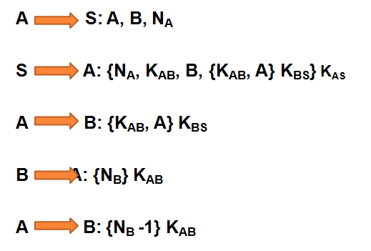
SYMMETRIC KEY PROTOCOL
.

Slide 11
PUBLIC KEY PROTOCOL
Alice (A) and Bob (B) use a trusted server (S) to distribute public keys on request. These keys are:
K_{PA} & K_{SA}, public and private halves of an encryption key-pair belonging to A.
K_{PB} & K_{SB}, similar belonging to B.
K_{PS} & K_{SS}, similar belonging to S.
Note : K_{SS} is used to encrypt while K_{PS} to decrypt.

Slide 12
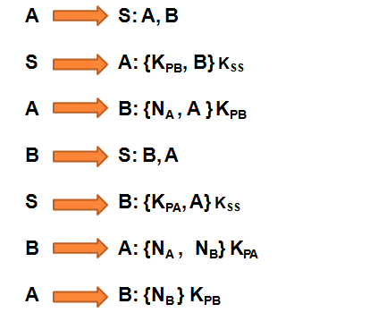
NEEDHAM-SCHROEDER PROTOCOL

Slide 13
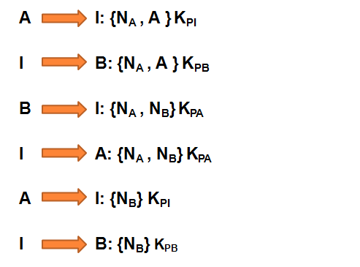
ATTACK ON NEEDHAM-SCHROEDER PROTOCOL

Slide 14
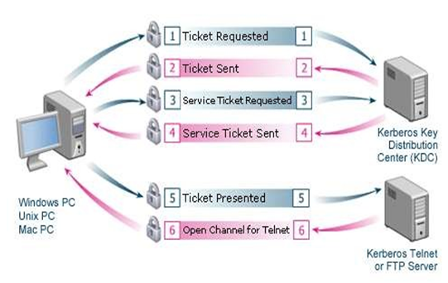
WORKING

Slide 15
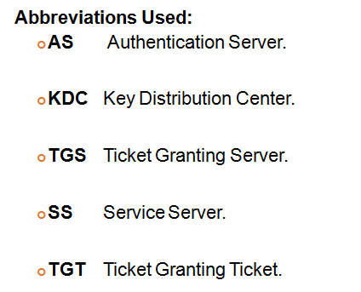
.

Slide 16
User Client-based Logon Steps:
A user enters a username and password on client
machine.
The client performs a one-way function on the entered password, and this becomes the secret key of the client/user.

Slide 17
Client Authentication Steps:
The client sends a message to AS requesting services on behalf of the user.
If client is in Database, AS sends back message which Client decrypts to obtain the Client/TGS Session Key for further communications with TGS.

Slide 18
Client Service Authorization Steps:
Client sends messages to TGS to get "client/TGS session key” using TGS secret key and sends following two messages to the client:
Client-to-server ticket encrypted using the service's secret key.
Client/server session key encrypted with the Client/TGS Session Key.

Slide 19
Client Service Request Steps:
The client now can authenticate itself to the SS.
The SS decrypts ticket to ultimately retrieve Authenticator and sends confirmation to client.
Client decrypts the confirmation using the Client/Server Session Key and connection is set up.

Slide 20
Services of Kerberos
¢Authentication
¢Authorization
¢Confidentiality
¢Within networks and small sets of networks

Slide 21
Weakness of Kerberos
Single point of failure.
Requires synchronization of involved host’s clocks.
The administration protocol is not standardized.
Compromise of central server will compromise all users' secret keys. If stolen, TGT can be used to access network services of others.

Slide 22
References
https://www.simplilearn.com/what-is-kerberos-article
https://www.geeksforgeeks.org/kerberos/
https://docs.axway.com/bundle/APIGateway_762_IntegrationKerberos_allOS_en_HTML5/page/Content/KerberosIntegration/kerberos_overview.html

Slide 23
E- Books Recommended
https://www.jigsawacademy.com/blogs/cyber-security/kerberos-authentication/
https://www.worldcat.org/title/kerberos-the-definitive-guide/oclc/780425105

